Slide 1
CS 295A/395D: Artificial Intelligence
Decision Theory
Prof. Emma Tosch
28 March 2022

Slide 2
Agenda
Wrapping up reasoning under uncertain state today
Introduce taking actions in the presence of uncertainty.
Elementary decision theory
Elementary game theory (making decisions given a game) concepts

Slide 3
Logistics
BB theory assignment out before next class
Update: bounties for real errors (will not be purposefully introducing errors)
Unlimited retries, soft deadline (recommended) before exam
Plan to wrap up this unit by Friday.
Next programming assignment out by the end of the week
Exam next week (Wednesday or Friday, to give you time to study)

Slide 4
Context: single decision
Two agents (“players”)
Take the perspective of a single player
Make one decision, under uncertainty
We will revisit game theory and search (e.g., minimax) after introducing reasoning over time

Slide 5
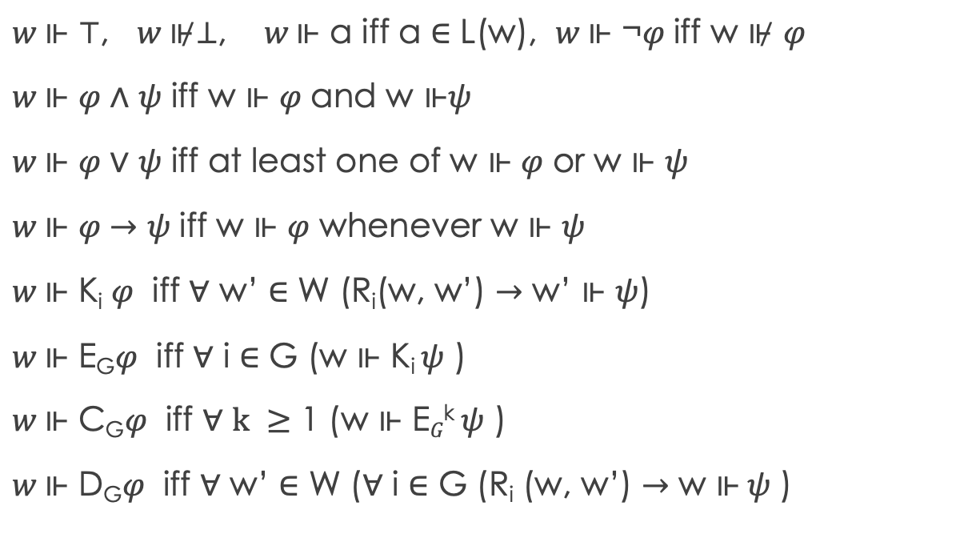

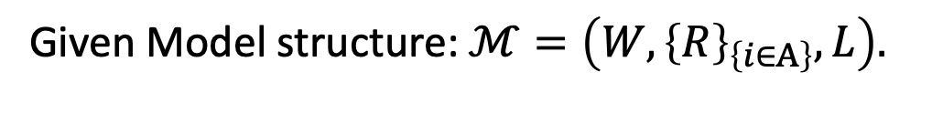
Recap: KT45^{n} syntax & Semantics
$$⊤ \left| ⊥ \right| p \left| ¬φ\right| φ_{1}∧φ_{2} \left| φ_{1}∨φ_{2} \right|{ φ}_{1}→φ_{2}$$
$$\left| {\text{K}}_{i}φ \right| E_{G}φ \left| C_{G}φ \right| D_{G}φ$$
Given Model structure: $ℳ=\left(W,{\left\{R\right\}}_{\left\{i∈A\right\}}, L\right).$
$w \text{⊩}$ ⊤, $w \text{⊮}$⊥, $w \text{⊩}$ a iff a ∈ L(w), $w \text{⊩}$ ¬𝜑 iff w ⊮ 𝜑
$w \text{⊩}$ 𝜑 ∧ 𝜓 iff w $\text{⊩}$ 𝜑 and w $\text{⊩}\text{ψ}$
$w \text{⊩}$ 𝜑 ∨ 𝜓 iff at least one of w $\text{⊩}$ 𝜑 or w $\text{⊩} \text{ψ}$
$w \text{⊩}$ 𝜑 $→$ 𝜓 iff w $\text{⊩}$ 𝜑 whenever w $\text{⊩ }\text{ψ}$
$w \text{⊩}$ K_{i} 𝜑 iff ∀ w’ ∈ W (R_{i}(w, w’) $→$ w’ $\text{⊩ }\text{ψ}$)
$w \text{⊩}$ E_{G}𝜑 iff ∀ i ∈ G (w $\text{⊩ }\text{Ki} \text{ψ}\text{ )}$
$w \text{⊩}$ C_{G}𝜑 iff ∀ $k ≥$ 1 (w $\text{⊩ }\text{E}G\text{k} \text{ψ}\text{ )}$
$w \text{⊩}$ D_{G}𝜑 iff ∀ w’ ∈ W (∀ i ∈ G (R_{i} (w, w’) $→$ w $\text{⊩} \text{ψ}\text{ )}$
w₂
p, q
R_{1,} R₂
w₁
R_{1,} R₂
q
p, q
w₃
R₁
w₄
p
q
R_{1,} R₂
w₆
w₅

Slide 6
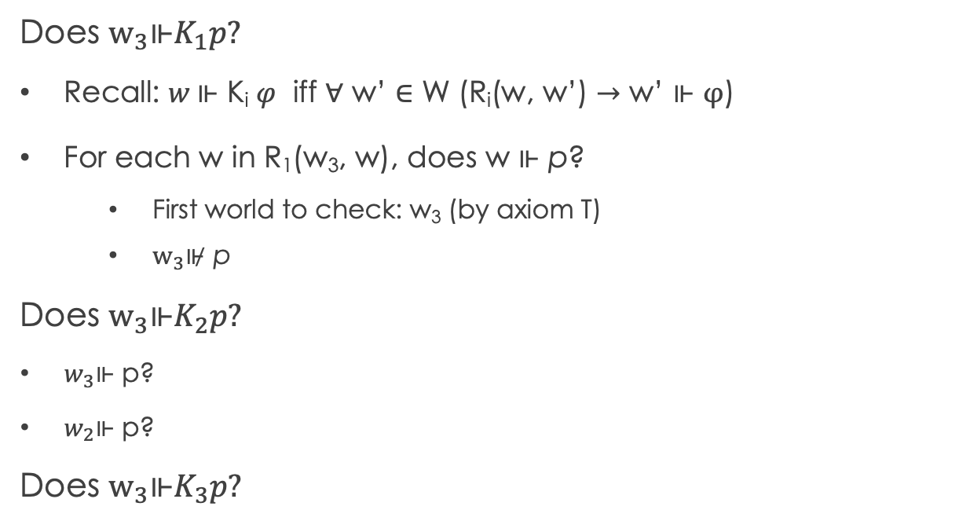
Recap: Evaluating formulas in KT45^{n}
Given Model structure: $ℳ=\left(W,{\left\{R\right\}}_{\left\{i∈A\right\}}, L\right).$
Does $w_{3}\text{⊩}K_{1}p?$
Recall: $w \text{⊩}$ K_{i} 𝜑 iff ∀ w’ ∈ W (R_{i}(w, w’) $→$ w’ $\text{⊩ }φ$)
For each w in R₁(w₃, w), does w $\text{⊩ }\text{p}$?
First world to check: w₃ (by axiom T)
$w_{3}\text{⊮} \text{p}$
Does $w_{3}\text{⊩}K_{2}p?$
$w_{3}\text{⊩}$ p?
$w_{2}\text{⊩}$ p?
Does $w_{3}\text{⊩}K_{3}p?$
w₂
p, q
R_{1,} R₂
w₁
R_{1,} R₂
q
p, q
w₃
R₁
w₄
p
q
R_{1,} R₂
w₆
w₅
Notes:
W2, w3

Slide 7
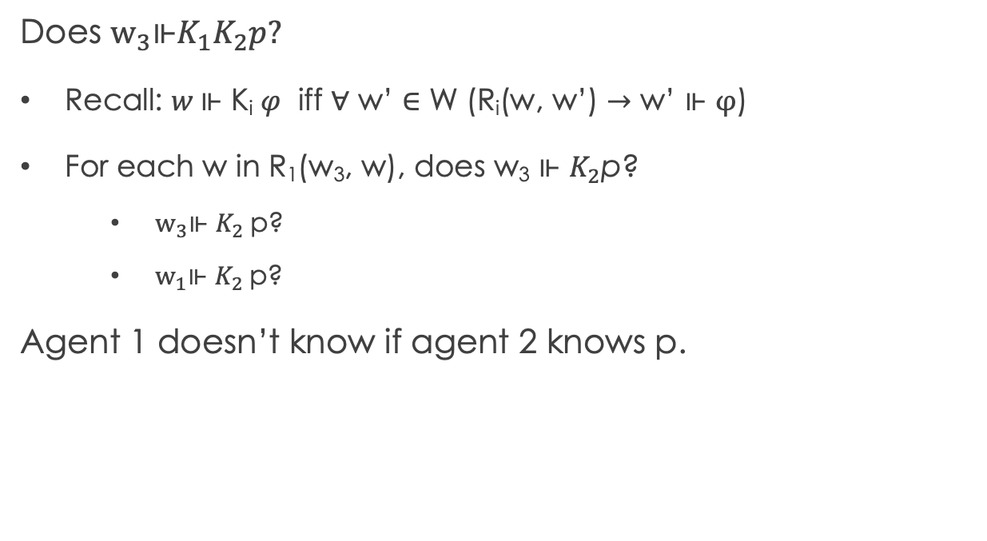
Recap: Evaluating formulas in KT45^{n}
Given Model structure: $ℳ=\left(W,{\left\{R\right\}}_{\left\{i∈A\right\}}, L\right).$
Does $w_{3}\text{⊩}K_{1}K_{2}p?$
Recall: $w \text{⊩}$ K_{i} 𝜑 iff ∀ w’ ∈ W (R_{i}(w, w’) $→$ w’ $\text{⊩ }φ$)
For each w in R₁(w₃, w), does w₃ $\text{⊩ }K_{2}\text{p}$?
$w_{3}\text{⊩} K_{2} \text{p}\text{?}$
$w_{1}\text{⊩} K_{2} \text{p}\text{?}$
Agent 1 doesn’t know if agent 2 knows p.
w₂
p, q
R_{1,} R₂
w₁
R_{1,} R₂
q
p, q
w₃
R₁
w₄
p
q
R_{1,} R₂
w₆
w₅
Notes:
W2, w3

Slide 8
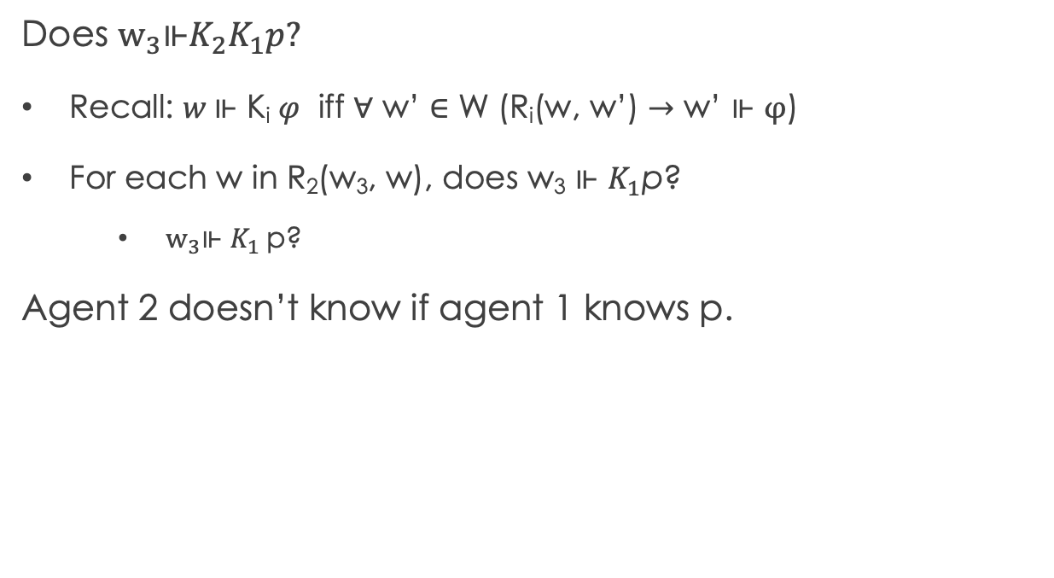
Recap: Evaluating formulas in KT45^{n}
Given Model structure: $ℳ=\left(W,{\left\{R\right\}}_{\left\{i∈A\right\}}, L\right).$
Does $w_{3}\text{⊩}K_{2}K_{1}p?$
Recall: $w \text{⊩}$ K_{i} 𝜑 iff ∀ w’ ∈ W (R_{i}(w, w’) $→$ w’ $\text{⊩ }φ$)
For each w in R₂(w₃, w), does w₃ $\text{⊩ }K_{1}\text{p}$?
$w_{3}\text{⊩} K_{1} \text{p}\text{?}$
Agent 2 doesn’t know if agent 1 knows p.
w₂
p, q
R_{1,} R₂
w₁
R_{1,} R₂
q
p, q
w₃
R₁
w₄
p
q
R_{1,} R₂
w₆
w₅
Notes:
W2, w3

Slide 9
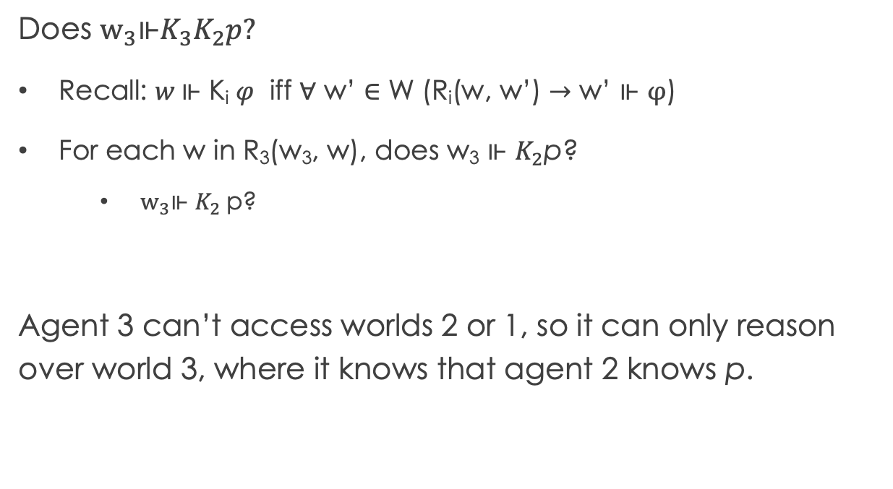
Recap: Evaluating formulas in KT45^{n}
Given Model structure: $ℳ=\left(W,{\left\{R\right\}}_{\left\{i∈A\right\}}, L\right).$
Does $w_{3}\text{⊩}K_{3}K_{2}p?$
Recall: $w \text{⊩}$ K_{i} 𝜑 iff ∀ w’ ∈ W (R_{i}(w, w’) $→$ w’ $\text{⊩ }φ$)
For each w in R₃(w₃, w), does w₃ $\text{⊩ }K_{2}\text{p}$?
$w_{3}\text{⊩} K_{2} \text{p}\text{?}$
Agent 3 can’t access worlds 2 or 1, so it can only reason over world 3, where it knows that agent 2 knows p.
w₂
p, q
R_{1,} R₂
w₁
R_{1,} R₂
q
p, q
w₃
R₁
w₄
p
q
R_{1,} R₂
w₆
w₅
Notes:
W2, w3

Slide 10
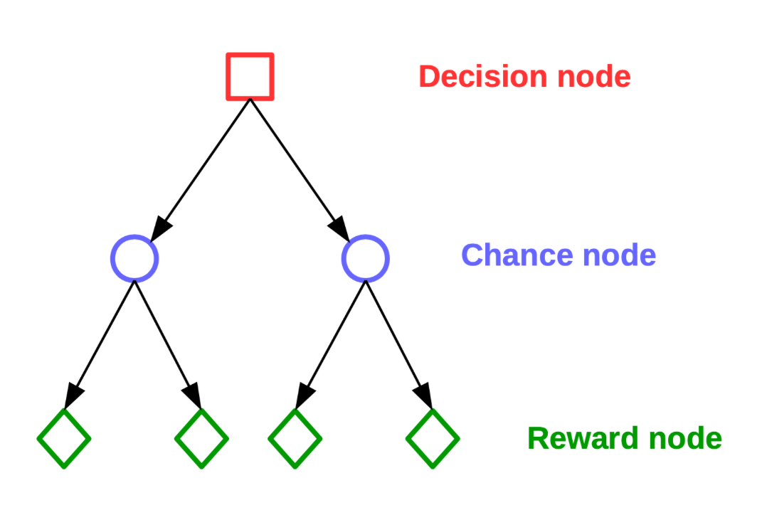
Basic Decision Theory
We can express taking actions in a world with uncertainty via decision trees
Decisions trees are temporally-ordered nodes where each level corresponds to alternating:
Decision nodes – state of the system; outgoing edges represent different actions
Chance nodes – probability distributions over outcomes; outgoing edges represent reachable states with some probability
Reward nodes – utility obtained from following the path
Note: “decision tree” also refers to a classification algorithm in machine learning and is completely different from the type of decision tree we will talk about here.

Slide 11
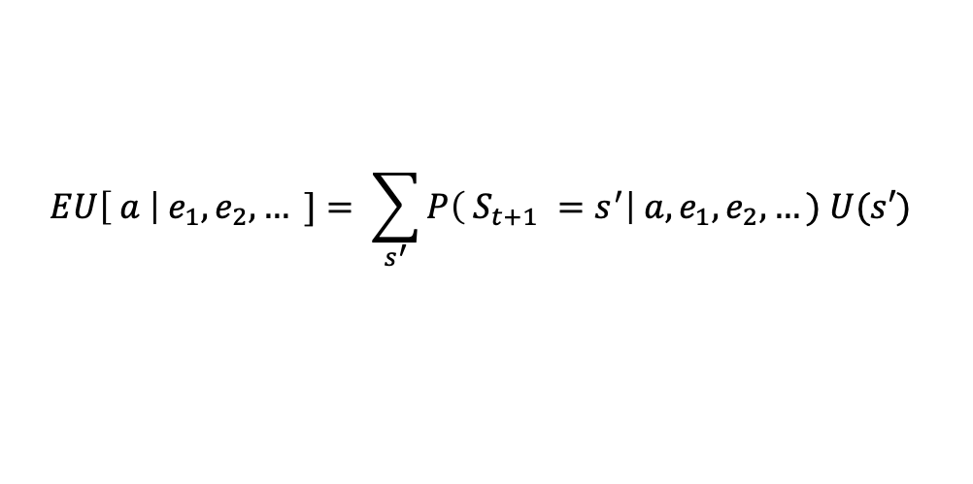
Goal: Maximize expected utility
$$EU\left[ a \right|{ e}_{1},e_{2},… ]= \sum_{s^{′}}{P\left( S_{t+1} =s^{′}\right| a, e_{1},e_{2},…) U(s′) }$$
Note: “decision tree” also refers to a classification algorithm in machine learning and is completely different from the type of decision tree we will talk about here.

Slide 12

Goal: Maximize expected utility
$$EU\left[ a \right|{ e}_{1},e_{2},… ]= \sum_{s^{′}}{P\left( S_{t+1} =s^{′}\right| a, e_{1},e_{2},…) U(s′) }$$
Best action is the action a that maximizes $EU\left[ a \right|{ e}_{1},e_{2},… ]$
Note: “decision tree” also refers to a classification algorithm in machine learning and is completely different from the type of decision tree we will talk about here.

Slide 13
Goal: Maximize expected utility
$$EU\left[ a \right|{ e}_{1},e_{2},… ]= \sum_{s^{′}}{P\left( S_{t+1} =s^{′}\right| a, e_{1},e_{2},…) U(s′) }$$
Best action is the action a that maximizes $EU\left[ a \right|{ e}_{1},e_{2},… ]$
Note: “decision tree” also refers to a classification algorithm in machine learning and is completely different from the type of decision tree we will talk about here.

Slide 14
Goal: Maximize expected utility
$$EU\left[ a \right|{ e}_{1},e_{2},… ]= \sum_{s^{′}}{P\left( S_{t+1} =s^{′}\right| a, e_{1},e_{2},…) U(s′) }$$
Best action is the action a that maximizes $EU\left[ a \right|{ e}_{1},e_{2},… ]$
Sum of the utility of actions taken.
Note: “decision tree” also refers to a classification algorithm in machine learning and is completely different from the type of decision tree we will talk about here.

Slide 15
Example: Buying a car
Problem setup:
Choice between 2 cars (C₁ and C₂), which can each be good (+) or bad (-) quality
Two tests that cost $$: (T₁ : $50, T₂: $20)
C₁ costs $500 below m.v., but if it’s bad quality, must be repaired for $700
C₂ costs $250 below m.v., but if it’s bad quality, must be repaired for $150
Must buy exactly one car and can perform at most one test before buying.

Slide 16
Example: Buying a car
P(C₁ = +) = 0.7
P(C₂ = +) = 0.8
Problem setup:
Choice between 2 cars (C₁ and C₂), which can each be good (+) or bad (-) quality
Two tests for each car that cost $$: (T₁ : $50, T₂: $20)
C₁ costs $500 below m.v., but if it’s bad quality, must be repaired for $700
C₂ costs $250 below m.v., but if it’s bad quality, must be repaired for $150
Must buy exactly one car and can perform at most one test before buying.

Slide 17
Example: Buying a car
P(C₁ = +) = 0.7
P(C₂ = +) = 0.8
P(T₁ = + | C₁ = +) = 0.8
P(T₁ = - | C₁ = -) = 0.65
P(T₂ = + | C₂ = +) = 0.75
P(T₂ = - | C₂ = -) = 0.7
Problem setup:
Choice between 2 cars (C₁ and C₂), which can each be good (+) or bad (-) quality
One test for each car that cost $$: (T₁ : $50, T₂: $20)
C₁ costs $500 below m.v., but if it’s bad quality, must be repaired for $700
C₂ costs $250 below m.v., but if it’s bad quality, must be repaired for $150
Must buy exactly one car and can perform at most one test before buying.
What are the expected costs of C₁ and C₂ assuming you run no tests? (Board 1)

Slide 18
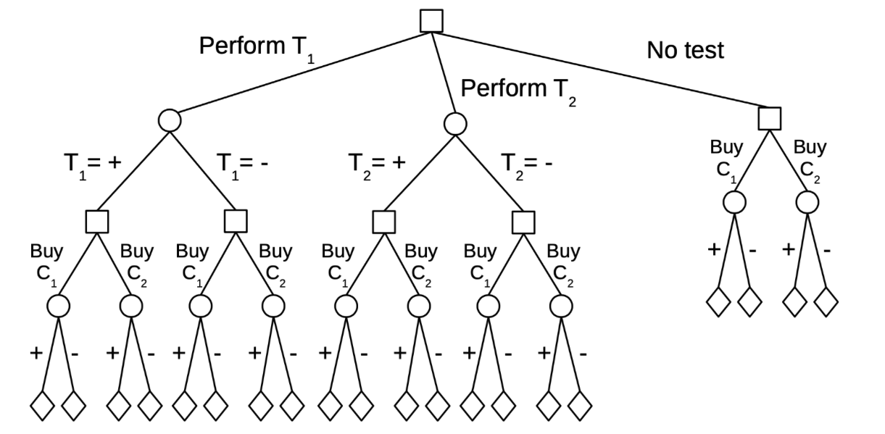

Slide 19
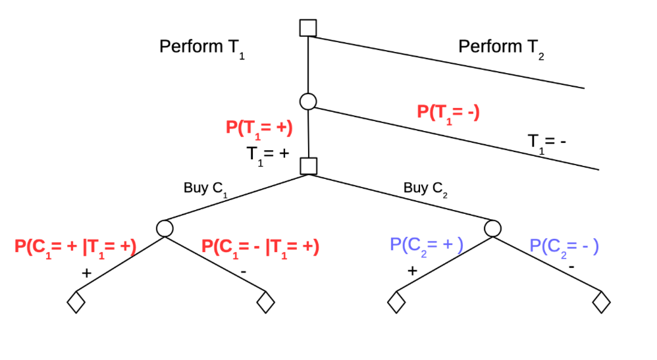
What is the expected cost of buying C₁ and C₂ assuming you run T₁ on C₁?
Set up decision between T₁ and T₂ (Board 2)

